Slide 1
LIBRARY MANAGEMENT SYSTEM
By LIM CHANVIRAKYUTH

Slide 2
5 PHASES OF SOFTWARE DEVELOPMENT
01
Idea
04
Testing
02
Solution
05
Maintenance
03
Coding
Project description and functional requirements
Testing and Deploying
Design the solution (logical and physical design)
Upkeep and Maintenance
Coding and Debugging
Notes:
Note: you can add between 3 and 6 sections, the structure can vary. The numbers have to be kept

Slide 3
01
Idea

Slide 4
LIBRARY MANAGEMENT SYSTEM
Description
Library Management System is a system for librarians to keep track of their books in the library. This system allows the admin to manage user accounts and the librarian to manage books in the system. Admin can add, edit, delete, search, view all users and sorting features. Librarians can add, edit, delete, search, view all books and sorting features.
Functional Requirements
Admin add, edit, delete, search, view all users and sorting features in the system.
Librarian add, edit, delete, search, view all books and sorting features in the system.

Slide 5
02
Solution

Slide 6
DESIGN THE SOLUTION
Logical Design
Physical Design

Slide 7
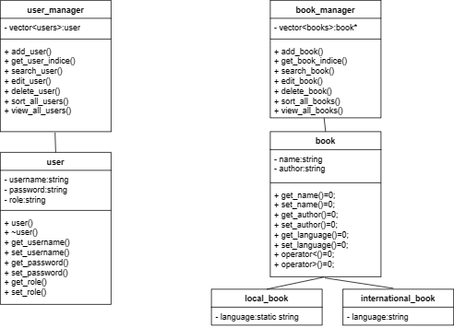
LOGICAL DESIGN
UML Class Diagram

Slide 8

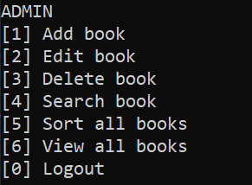
PHYSICAL DESIGN
User Interface

Slide 9
03
Coding and Debugging

Slide 10
04
Testing

Slide 11
05
Documentation and Maintenance

